Slide 1

Preflight Check List
Everyone:
Sign into our Zoom meeting through our integrated Blackboard/Zoom link
Make sure that you can hear the conversation, see shared desktops, and view group chat topics
You will need a headset with a microphone to be able to effectively listen and speak
You will need to be able to share your computer screen
Thank you if you choose to leave your camera on to help make our class more interactive
In person participants also:
Make sure that your microphone and speakers are muted/off so that we don’t get an echo
Sit in a good spot near the classroom ceiling microphones if possible

Slide 2
Agenda:
Prework and Announcements
Software Engineering Perspectives & Priorities
Sprint 5 Planning Q&A
Architectural Analysis Discussions
Final Project Proposals Scrum Team Discussions
Discussion Board 5: Final Project Proposal
Prework for Next Class
Discussion & Questions welcome at any time but please be present with no phones or email during our time together

Slide 3
Prework
Complete through activity 5 prior to next class
Be prepared for a scrum team chapter 9 on Software Maintenance

Slide 4
Perspectives & Priorities
Perspectives:
Process
Technology
Customer (User)

Slide 5
Perspectives & Priorities
Process:
Waterfall
Iterative
Agile
CMMI and ISO
Technology:
Architecture & Design,
Languages, Tools, and Platforms
Customer (User):
Epics, Features, Stories

Slide 6
Perspectives & Priorities
Agile Priorities:
Customer
Technology
Process

Slide 7
Review Activities List and Assignments

Slide 8
Sprint 5 Planning Q&A

Slide 9
Architectural Analysis Discussions

Slide 10
Recall Perspectives & Priorities
Agile Priorities:
Customer
**Technology**
Process

Slide 11
Recall Architecture Analysis Papers
As a team select one of the following topics and perform a P&D style architectural analysis. Pick something that is interesting to your team and that you feel would likely be useful in your eventual final project. The analysis should be done in the context of enhancing our current Azure, Node.js, and Express software as a service (Saas) platform by:
Utilizing React
Utilizing React and React Bootstrap
Utilizing Azure-based Authentication/Authorization (preferably that can utilize our Office 365 credentials)
Utilizing Azure Tables
Utilizing Azure Functions
Utilizing and Azure Database

Slide 12
Recall Saas Layers
Layers:
Presentation
Logic
Data

Slide 13
Architectural Analysis Discussions

Slide 14
Architectural Analysis Discussions

Slide 15
Final Project Discussions
Application Name (2 minutes)
Application Purpose and Key Features (10 minutes)
Sass Layers (8 minutes)
Notes:
Seating chart and attendance tracker (virtual and in person)

Slide 16
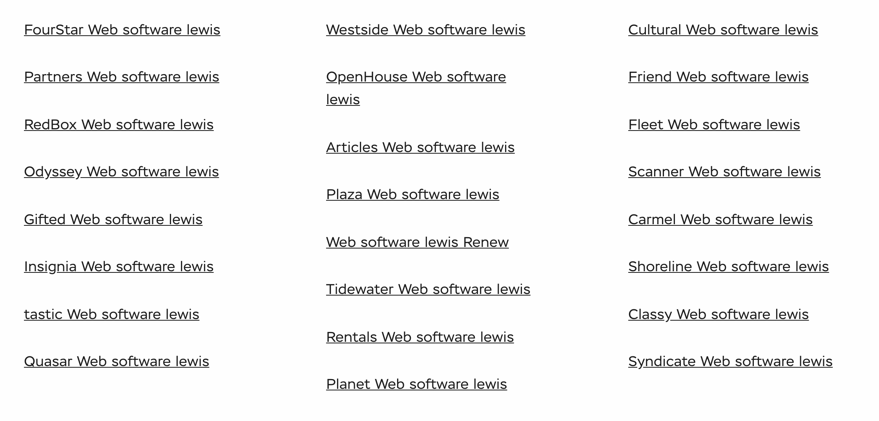
Lab
Final Project Teams and Application Names

Slide 17
Application Purpose and Key Features
Notes:
Seating chart attendance tracker contact tracer
Data driven syllabus creator
Test/Quiz application
Weather, Sports, Valdiator

Slide 18
Sass Layers

Slide 19
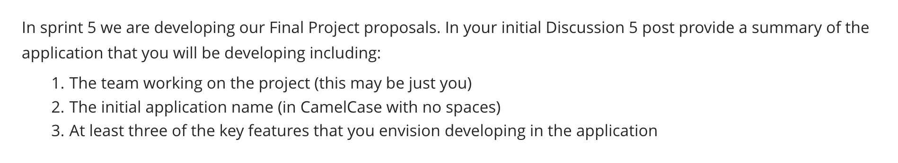
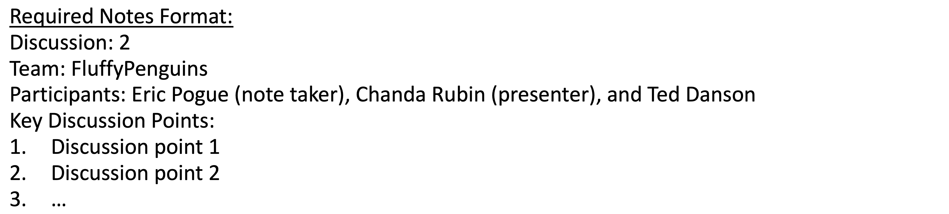
Scrum Team Discussion Board 5
Assign note taker and presenter roles to team members
Review and discuss the discussion topic for this sprint for approximately 10 minutes
Note taker takes notes and presenter prepares a report out summary
Note taker share notes with all participating team members
Each team member pastes and submits exact copy of the notes into their discussion board
Sit back, relax, and tell the note taker and presenter what I wonderful job the did

Slide 20
Report Out
Notes:
Seating chart attendance tracker contact tracer
Data driven syllabus creator
Test/Quiz application
Weather, Sports, Valdiator

Slide 21
Prework For Next Class
Complete through activity 9 prior to next class
Be prepared for a scrum team chapter 9 on Software Maintenance

Slide 22
End of Session

Slide 23
Friendly Conversation Topic

Slide 24
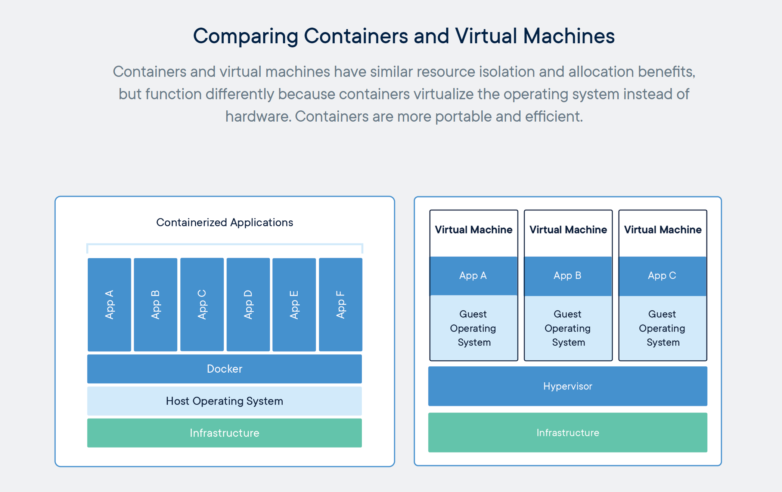
Containers & Docker [link]

Slide 25
Kubernetes & Swarm [link]

Slide 26
Metrics

Slide 27
Submission Percentage from Sprint 1

Slide 28
Submission Percentage from Sprint 2

Slide 29
Submission Percentage for Sprint 3

Slide 30
Submission Percentage for Sprint 4

Slide 31
Prework
Complete through activity 5 prior to next class
Be prepared for a scrum team chapter 9 on Software Maintenance
Scrum Team Review of Software Maintenance
Metrics

Slide 32
Waterfall vs Iterative vs Agile Requirements
 | Waterfall | Iterative | Agile
References | United States Department of Defense: DOD-STD-2167A (1985) | Rational Unified Process (RUP) Open Unified Process | Scrum Kanban Scaled Agile Framework (SAFe)
Priorities | Planning and predictability | Architecture, modeling, and efficiency through early detection & fixing of issues (verification) | Responsiveness to feedback, efficiency through engineering practices, early detection & fixing of issues, and validation
Principles | Execute phases sequentially: Requirements Analysis Design Coding Testing / Validation and Operations Define and commit to Scope, Cost, and Timeline “early” Implement strict Change Control | Manage requirements Develop and test iteratively Validate quality iteratively Use components Model visually Control changes | Capture lightweight near term requirements Allow requirements to evolve but maintain fixed timelines Develop, test, deploy, and release iteratively Validate and Verify quality iteratively Empower teams Apply engineering practices and systems thinking Integrate early user feedback into remaining plan Maintain a collaborative approach between all stakeholders
Notes:
The views on testing and change management have changed dramatically as organizations have moved from Waterfall to Iterative to Agile development lifecycles.
Successful Agile (and Iterative) Development REQUIRES better application design, development techniques, and testing practices.
Testing and lack of defects are not the end goal. A higher quality more usable more cost-effective product is the goal.
Requirements:
Waterfall:
Full project requirements upfront
Inconsistent industry capture techniques
Tend to be verbose requirements with formal signoff
Change requests needed
Estimation bottom up detailed estimates sometimes function points
Iterative:
Mostly upfront

